Slide 1
Main Pod Code Guide
V4
March 2025

Slide 2
For Existing Users:
Re-download main_pod_code_2025.mat
Re-download Addtl. Matlab Functions folder
Re-download Logs folder
Delete any existing .mat pod files in colocation or field folders
Code will re-convert them to .mat reflecting new formats

Slide 3
Calibration Methods

Slide 4
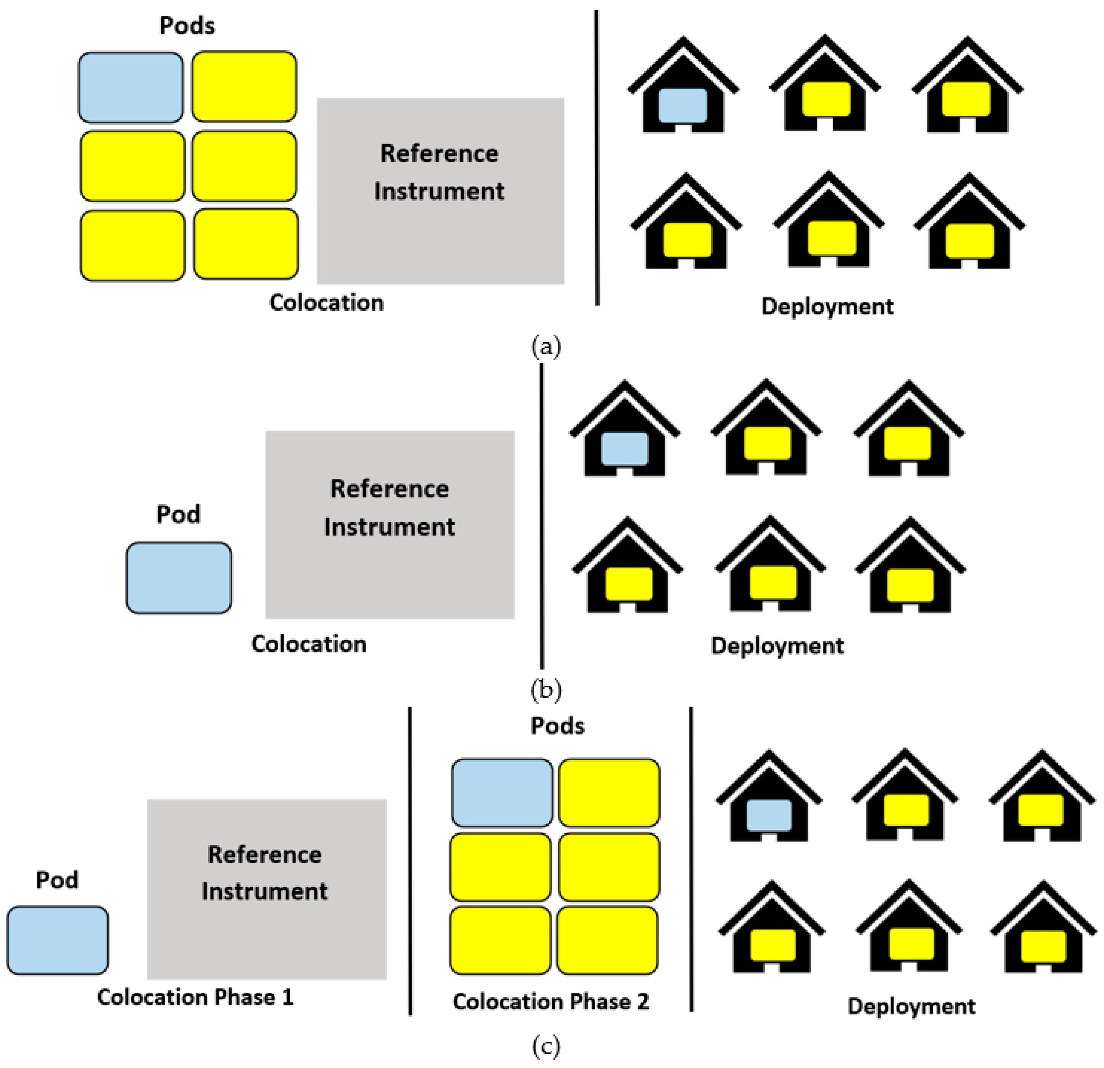
What is Individual Calibration?
Each pod has its own distinct calibration mode
E.g. for these 6 pods, 6 unique sets of calibration coefficients

Slide 5
What is universal (multi-pod) calibration? One-Cal
Only one pod needs to be co-located with a reference instrument
One calibration model is generated, then applied to all 6 pod
Only 1 calibration model total

Slide 6
What is universal (multi-pod) calibration? One-Hop
One pod is normalized, then treated as a “reference” instrument in a secondary colocation to normalize the rest of the pods
6 calibration models total:
1 derived from reference instrument
5 from using the calibrated pod as a “reference” instrument

Slide 7
Getting Set up in Matlab

Slide 8
Matlab Version
Optimized for use with R2021b
Can still use with newer versions, but may experience bugs

Slide 9
Additional Matlab toolboxes needed
The following MatLab toolboxes are required to run the main script and associated plotting functions:
Deep Learning Toolbox
Statistics and Machine Learning Toolbox
Curve Fitting Toolbox
Optimization Toolbox
Econometrics Toolbox

Slide 10
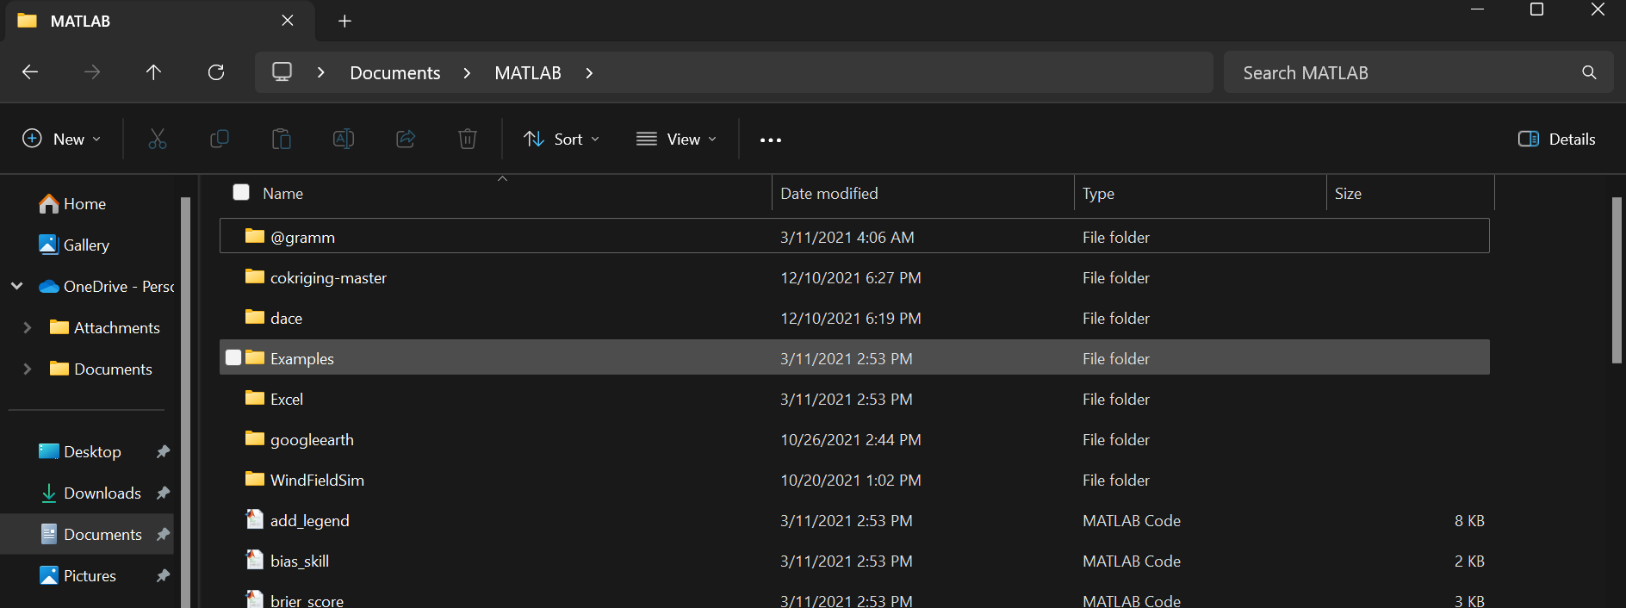
Additional Matlab toolboxes needed
Gramm is required for most plotting functions
Download here: https://www.mathworks.com/matlabcentral/fileexchange/54465-gramm-data-visualization-toolbox
Download as a zip file
Unzip on your computer
In the MATLAB folder on your computer (auto-generated when you download Matlab), add the contents of the gramm folder as shown here:

Slide 11
Folders You’ll Need to Run the Code

Slide 12
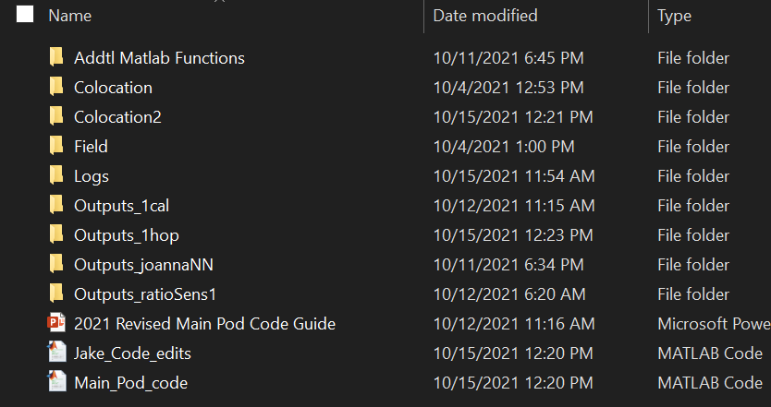
Folders You’ll Need to Run the Code
Need certain folders saved to your computer that the code will know to pull files from:
Addtl Matlab Functions
Version must be October 2021 or later
Colocation
Colocation2
If using one-hop, otherwise don’t need
Field
Logs
These go in the same folder as the code you want to run

Slide 13
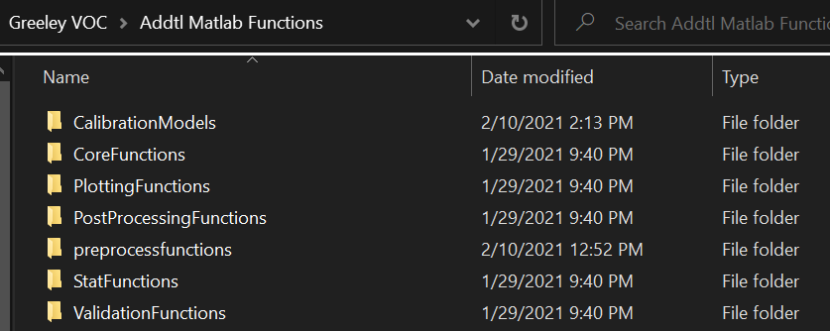
Folders You’ll Need to Run the Code > Addtl Matlab Functions
Houses all of the sub-functions the code uses
Don’t edit this unless you want to create a new calibration model, make a new type of plot, etc.

Slide 14
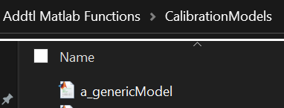
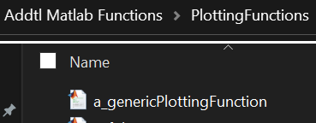
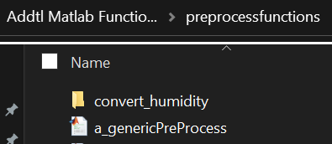
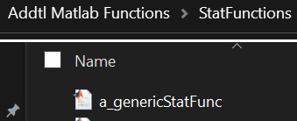
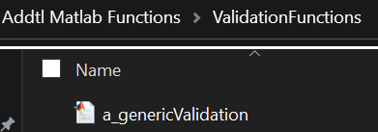
A note on Addtl Matlab Functions
Most sub-folders have an example function to use as a template when writing your own
Titled: a_generic(FunctionType)

Slide 15
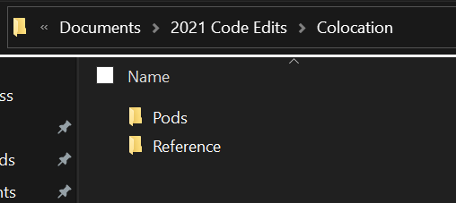
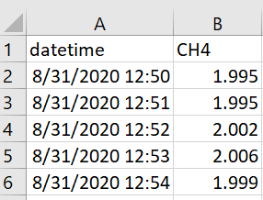
Folders You’ll Need to Run the Code > Colocation
Split into 2 sub-folders:
Pod:
Place raw .txt files here for your co-location data
Code will automatically turn any new .txt files to .mat files
Need at least 2 pods in here for the code to run
If universal cal (only one pod), put a dummy file in
Reference:
Place the reference data here in .csv format (Excel)
Needs 2 columns: datetime & [pollutant name]
Code will automatically convert it to .mat file
If coarse & fine PM, need to manually split into PM10, 5, etc.

Slide 16
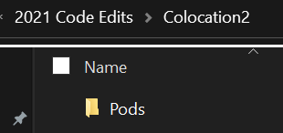
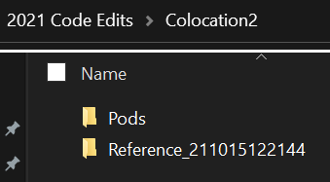
Folders You’ll Need to Run the Code > Colocation2
Before running code
Only for one-hop
You only need to create the “Pods” folder
Pods:
Place raw .txt files here for your secondary co-location data
Code will automatically turn any new .txt files to .mat files
Need at least 2 pods in here for the code to run
Reference:
Will be automatically generated by the code
After running code

Slide 17
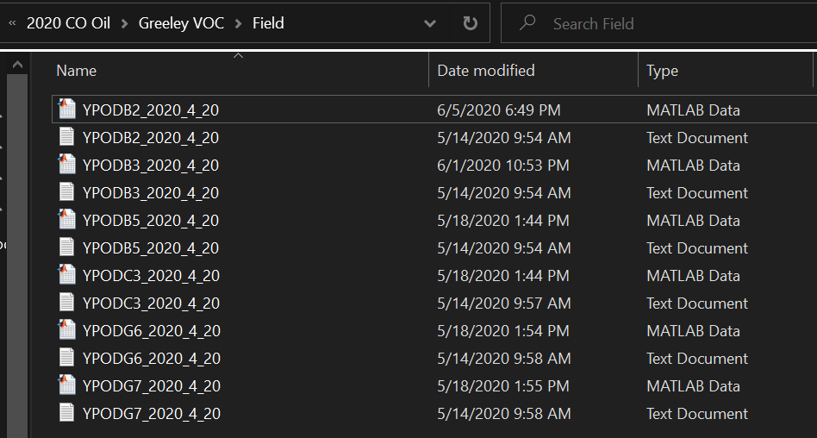
Folders You’ll Need to Run the Code > Field
Place raw .txt files here for your field / deployment data
Code will automatically turn any new .txt files to .mat files
If changes are made to raw .txt files, delete the corresponding .mat files so code regenerates those

Slide 18
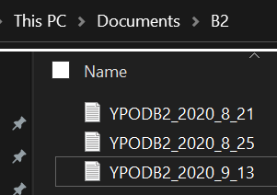
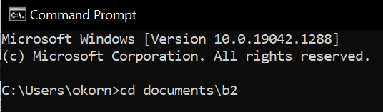
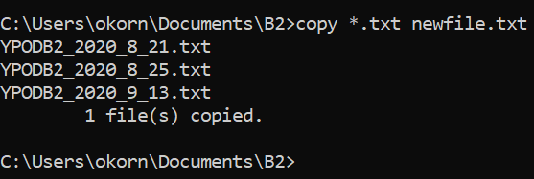
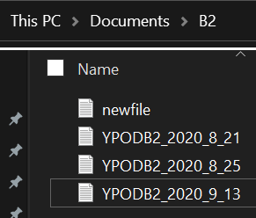
A note on pod .txt files
If more than one file for each pod during colocation or field, best to combine them
Combine multiple colocation files or multiple field files
Don’t combine colocation with field
Can do this using windows command line
Add multiple field files for the same pod to one folder
Open command prompt by typing “cmd” into windows search bar
Type “cd” then the directory of your new folder
Copy & paste: copy *.txt newfile.txt
This will create an additional file with all combined

Slide 19
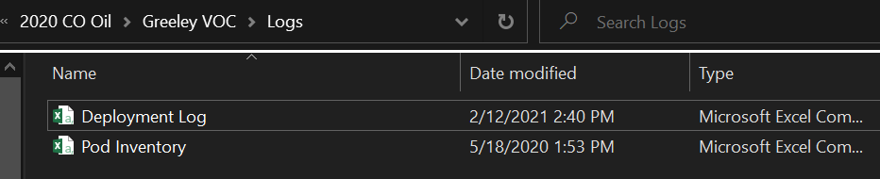
Folders You’ll Need to Run the Code > Logs
Contains 2 .csv files (Excel)
Deployment Log
Pod Inventory

Slide 20
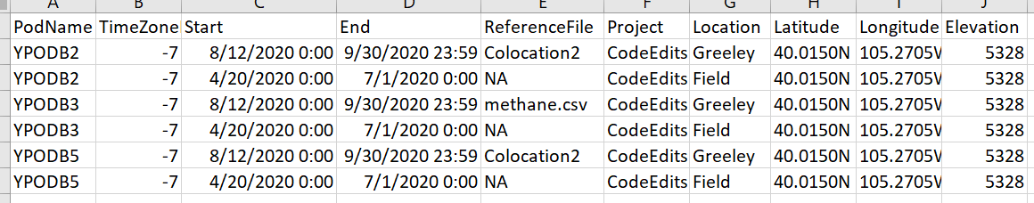
Logs > Deployment Log.csv
Needs to have the first 5 headings
The rest are good to have for the database but not required for code to run
Separate entries for each pod’s co-location & deployment
PodName: needs to be UPODB2, YPODB2 (not just B2)
TimeZone: difference from UTC (-7 or -8 for CO)
ReferenceFile:
For co-location, the name of the file in Colocation > Reference folder
For 1-hop: Colocation2
For deployment/field data: just put NA

Slide 21
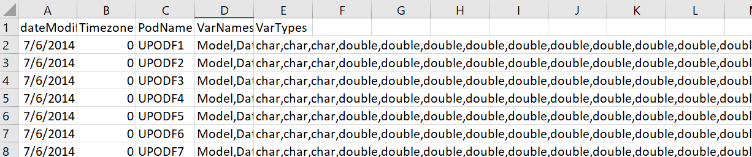
Logs > Pod Inventory.csv
Update this from previous versions – some names have changed
Use these exact column headings
Timezone: leave as 0
Assumes UTC as timezone
Need to have an entry for each pod used
Must be UPODB2, YPODB2 (not just B2)

Slide 22
Logs > Pod Inventory.csv
VarNames: lists the names you want for each column in the pod text file
E.g. you’ll add “ptPM1, ptPM2.5, ptPM10” as variables 9, 10, 11 etc.
VarTypes: lists the type of input this column will be
E.g you’ll add “double, double, double” as variables 9, 10, 11 etc.

Slide 23
SettingsSet

Slide 24
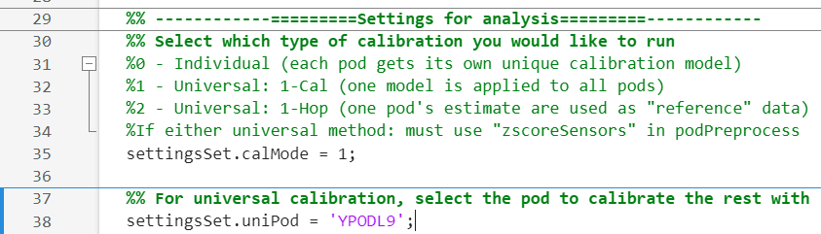
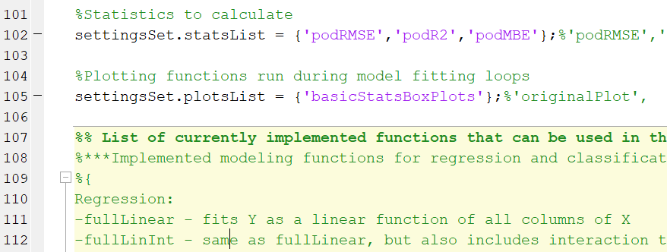
settingsSet
Modify settings here (begins line 23)
All variables to be edited start with settingsSet
The rest of the code should remain untouched
You don’t edit anything below here
(end of settingsSet)
Starts line 29

Slide 25
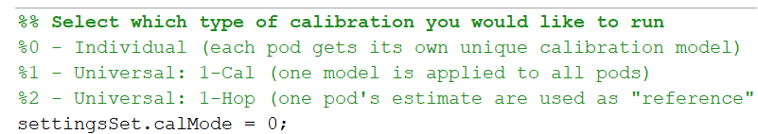
settingsSet > calibration mode (calMode)
Determines if individual or either type of universal cal is run
0 – individual calibration
1 – universal calibration using one-cal method
2 – universal calibration using one-hop method

Slide 26
settingsSet > universal Pod (uniPod)
If using either universal calibration method: which pod you want to use to calibrate the rest
Can leave blank if doing individual calibration

Slide 27
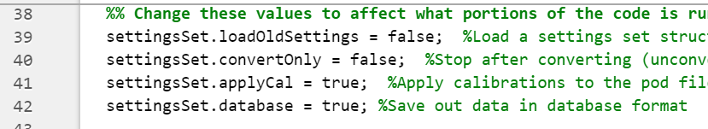
settingsSet > portions of code to run
For field application, applyCal must be true
If you want text files to save to the database, database must be true

Slide 28
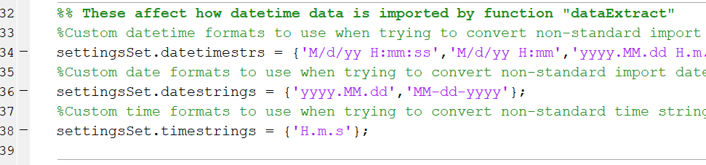
settingsSet > datetime
Default settings are what works best for Y-Pod data & later
Only change if using U-Pod data or older

Slide 29
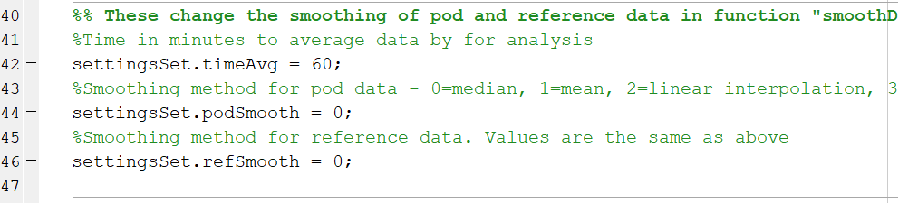
settingsSet > Averaging
Chose time averaging (minutely, hourly, etc.) based on resolution of reference data
Can also choose “smoothing” method for making data minutely, hourly, etc.

Slide 30
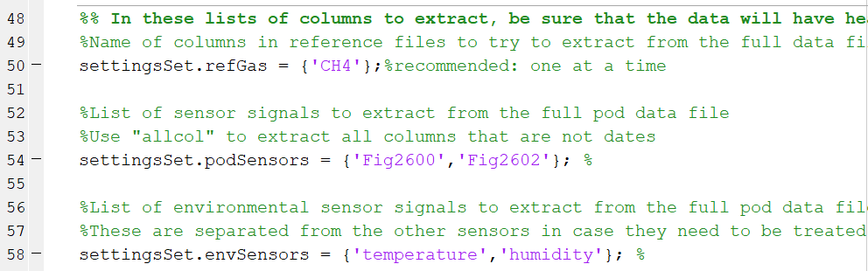
settingsSet > data extraction
Choose reference gas
Must match the column name in the reference folder
Do one reference at a time! E.g. if you want to look at both CH4 & CO, run code twice instead of listing both in one run
Choose which pod pollutant sensors to import
Choose which pod environmental sensors to import
Only import columns you need to quantify pollutant of interest
Importing them all slows things down
Can confuse the calibration model

Slide 31
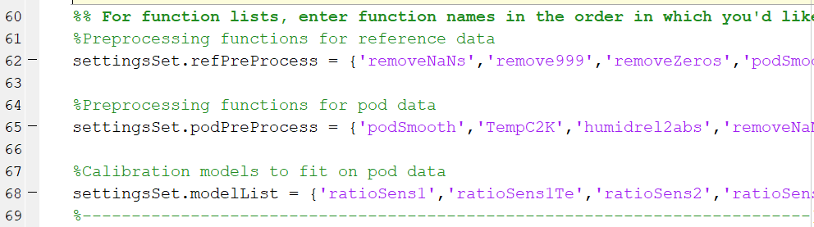
settingsSet > function names
Choose what pre-processing to use for reference data
In this section, choose whether to use voltage, resistance, or normalized resistance
Choose what pre-processing to use for pod data
From Addtl. Matlab Functions > preprocessfunctions for both
Choose which calibration model(s) to run
From Addtl. Matlab Functions > Calibration Models
Function names must appear in “Addtl. Matlab Functions” folder

Slide 32
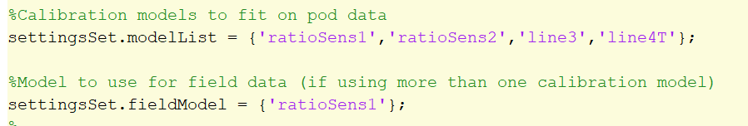
settingsSet > function names
If using field application (apply cal), choose one model to use on field data
From Addtl. Matlab Functions > Calibration Models
This same model needs to be used in modelList
Can use as many models as you want in modelList, but only one in fieldModel

Slide 33
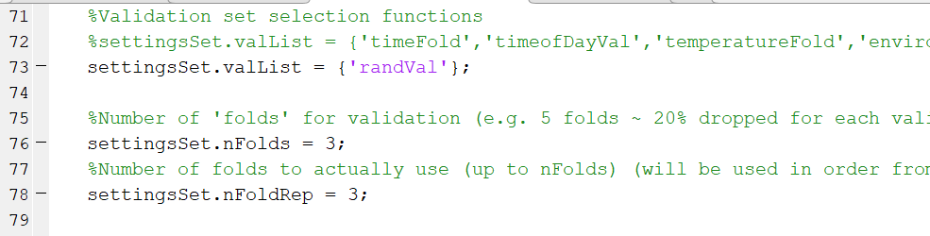
settingsSet > function names
Next few functions deal with splitting co-location data into calibration & validation
valList – what method to split into cal & val
Needs to be a filename from Addtl. Matlab Functions > ValidationFunctions
Select data randomly, group based on time of day, temperature, etc.
nFolds & nFolds rep – what percentage of data is used for validation
5 folds = 20%, 3 folds = 33%, etc.

Slide 34
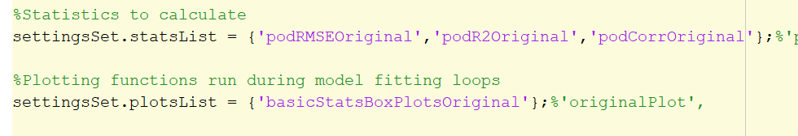
settingsSet > function names
statsList – which statistics to calculate for co-location fits
Addtl. Matlab Functions > StatFunctions
Need the 3 listed here to run ‘basicStatsBoxplots’
plotsList – plot stats, timeseries, etc. for co-location fits
Addtl. Matlab Functions > PlottingFunctions

Slide 35
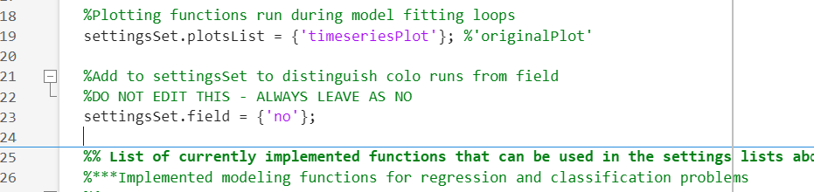
settingsSet > field
DO NOT EDIT THIS ENTRY!! ALWAYS LEAVE SET AS ‘no’
The code will automatically run any pod pre-processing to both the colocation and field data. This is for any pre-processing that should be applied to the field data (rare case).

Slide 36
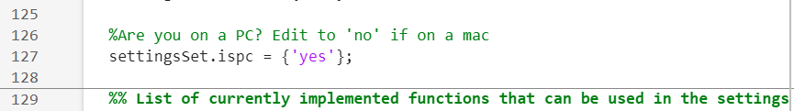
settingsSet > ispc
The last entry in the settingsSet
If you’re on a pc, leave as is
If on a mac, change to ‘no’

Slide 37
Calibration Models

Slide 38
Recommended CalibrationModels
For O3 & CO2: ‘rf_plain’ or ‘rf_plainTe’
For CH4 & HCHO: ‘rf_HCHO’ or ‘rf_HCHO_Te’
For NO2: have not used recently, but recommend using both the NO2 & O3 sensors for better fits. Can also try including additional electrochemical sensor (CO).
Rf are all random forest models
For shorter deployments, the elapsed time term (Te) may cause models to overfit, which leads to issues with field data – try both & look carefully at the field outputs!

Slide 39
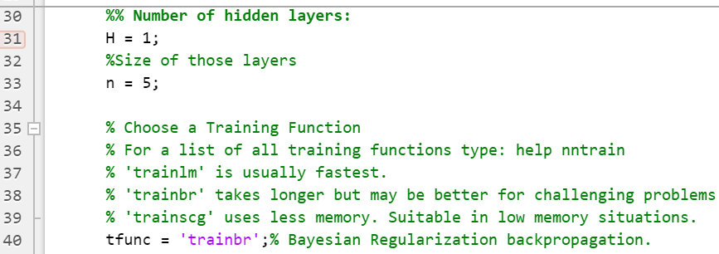
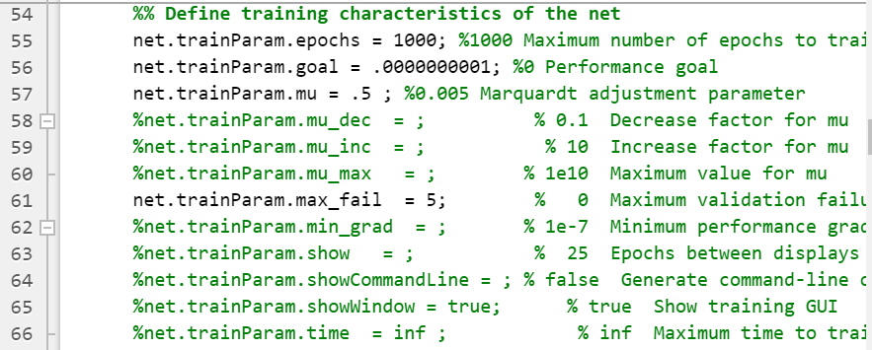
A note on joannaNN and ANNs
joannaNN is a base ANN model
Can tweak parameters (some examples shown below) in this function
Or create other versions named accordingly
e.g. joannaNN_10n_lm_100e, joannaNN_ratioSens1

Slide 40
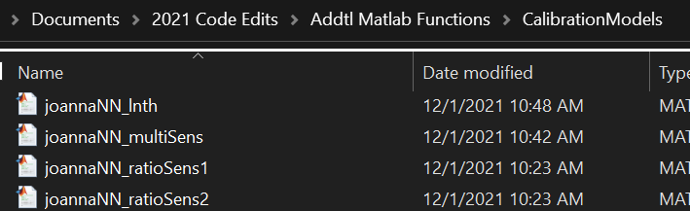
A note on joannaNN and ANNs
joannaNN just uses whichever sensor columns you selected
From podSensors & envSensors
E.g. Fig2600, Fig2602, temperature, humidity
Add interaction terms by calling the corresponding cal model instead
E.g. products & ratios of metal oxide sensors, temp & hum interactions

Slide 41
Recommended Plots
*these are all for colocation data. Field plots are generated outside of this code!

Slide 42
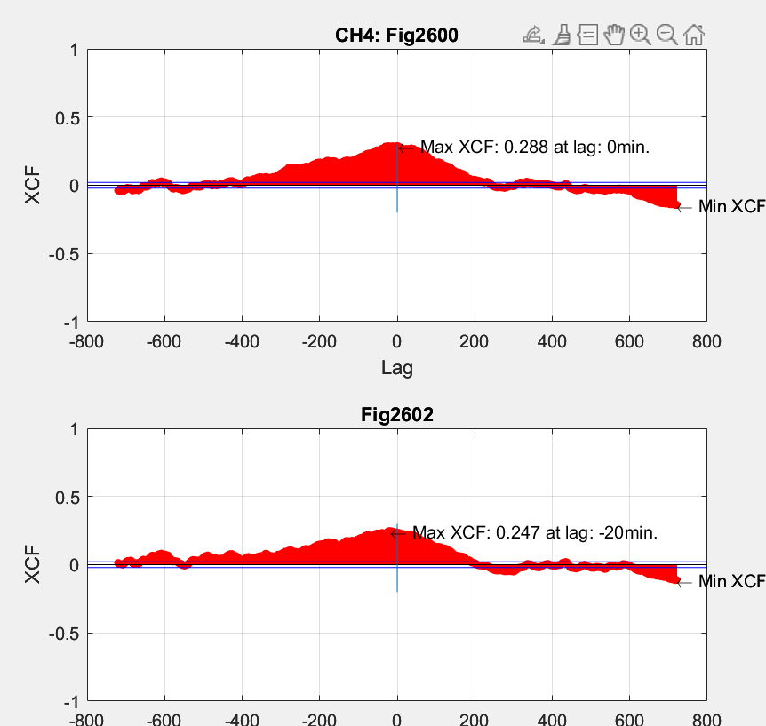
PlottingFunctions > acfPlot
Autocorrelation function
More info here: https://www.geeksforgeeks.org/autocorrelation/
For our purposes, helps us figure out if our time zones between the pods and reference instrument are misaligned
If lag = 0 or lag < ~30 min, time zone is ok
If lag > 30 min, try adjusting time zone in deployment log
2 examples of reliable data (small or no lags)

Slide 43
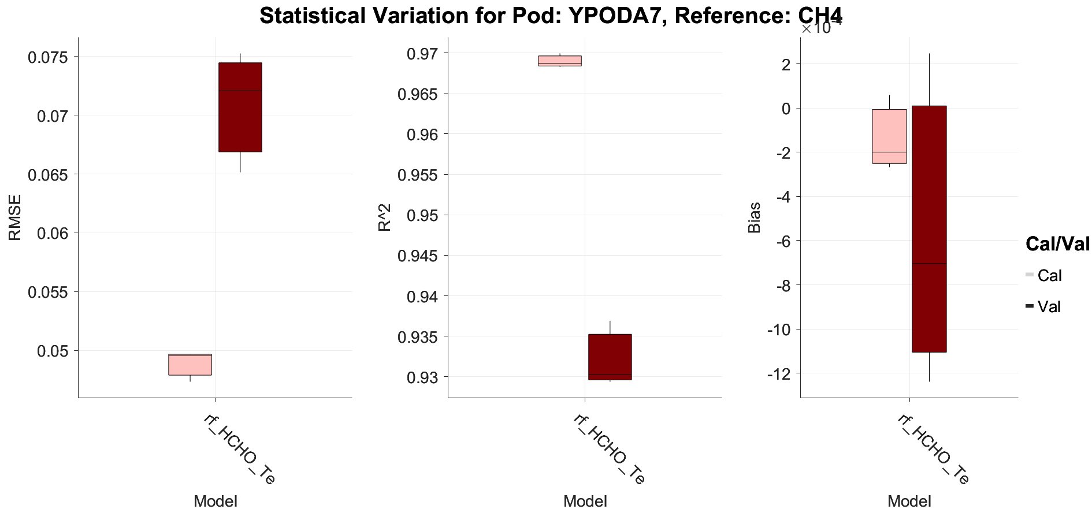
PlottingFunctions > basicStatsBoxPlots
Plots the statistics for goodness of fit for each pod
Since each pod is split into folds for testing & training, will have a range of values for each pod
We usually report out the median of these values (center line on each box)
Default stats included: R2, RMSE (root mean square error) MBE (mean bias error)
More options of stats available in Addtl Matlab Functions > StatFunctions

Slide 44
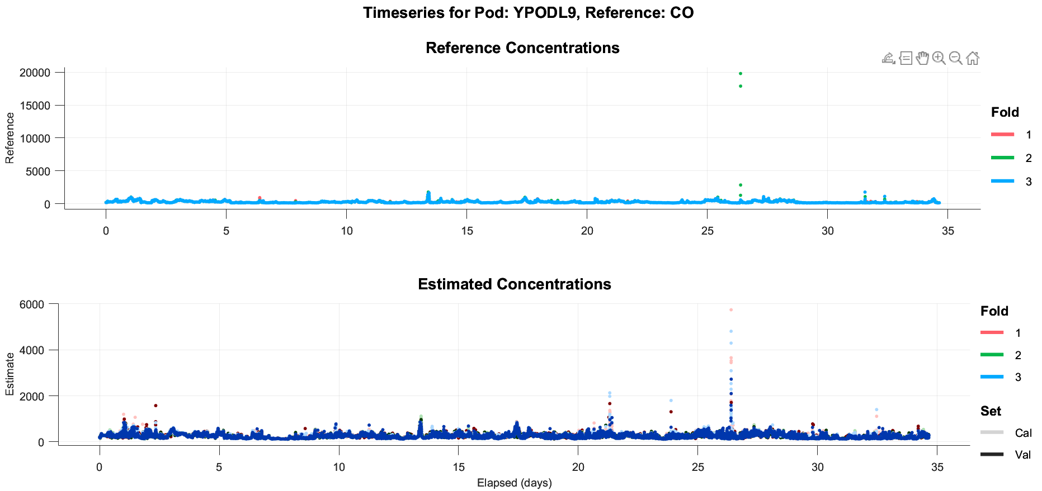
PlottingFunctions > timeseriesPlot
Shows timeseries of the reference data on top and the calibrated sensor data on bottom for comparison purposes

Slide 45
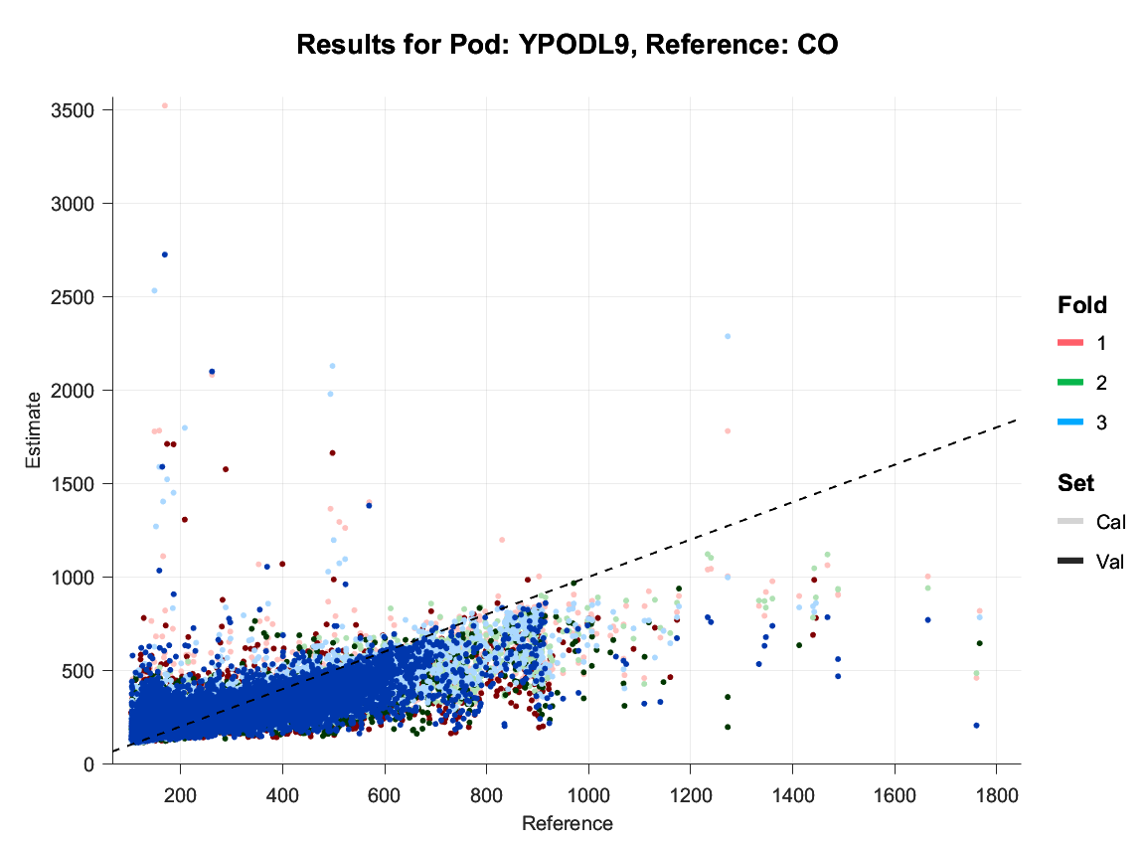
PlottingFunctions > vsReferencePlot
Plots the reference data on the X axis and our calibrated pod data on the Y axis
If our fit was perfect, it would be a perfectly straight line with equation y = x (y = mx + b, where slope m =1 and intercept b = 0)
Deviation from the 1-1 line helps us determine where the model over or under estimates
In this example, the trailing points let us know that the model overestimates for small CO values and underestimates for high CO values

Slide 46
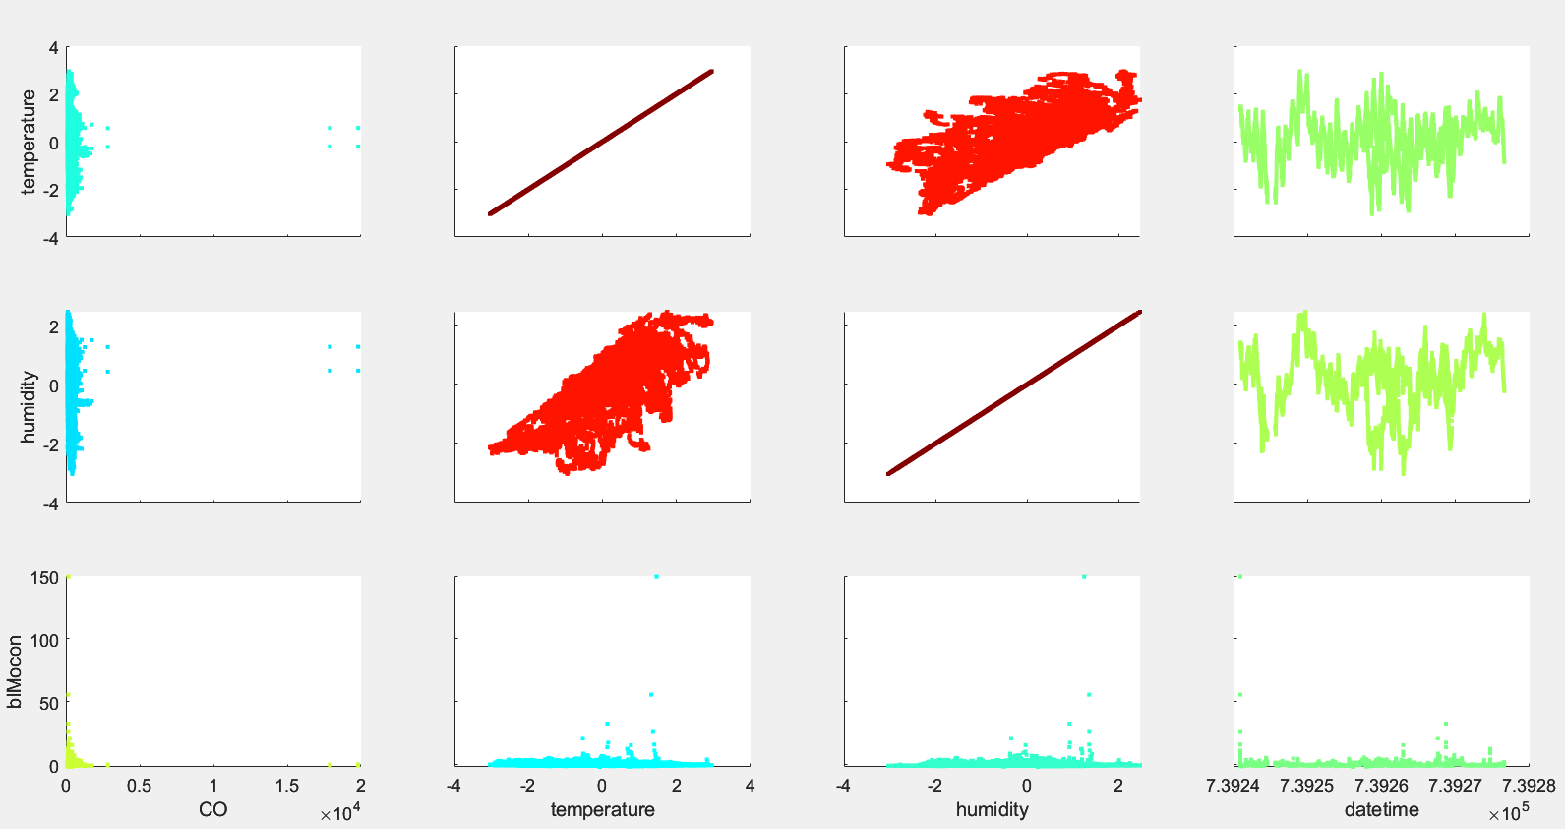
PlottingFunctions > XYCorrelations
Plots each included pod variable against each other to help us look for trends or issues
The straight lines are where the variable is being compared against itself

Slide 47
Body of Code

Slide 48
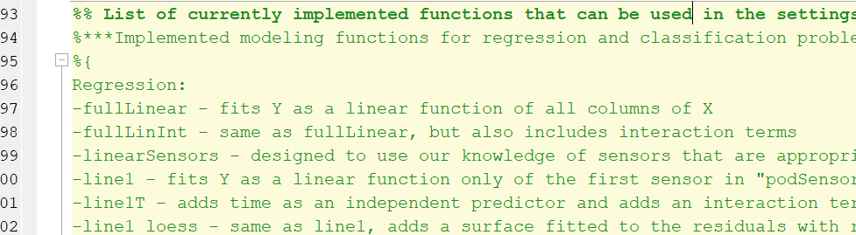
List of Functions
Jake had compiled a list of many functions available in Addtl. Matlab Functions with a description of each
There are others I added not included here – ask!

Slide 49
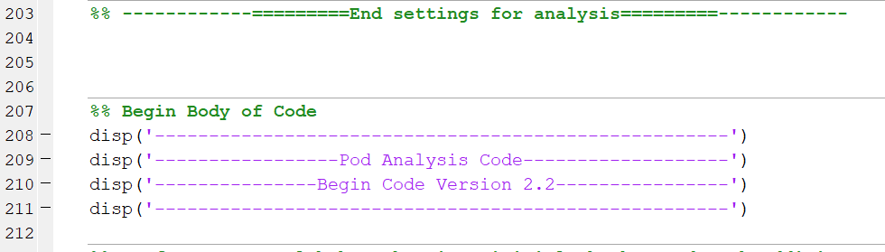
Begin Body of Code
This is where everything happens!
Shouldn’t need to edit anything below here

Slide 50
Outputs

Slide 51
Outputs > General
Naming convention: Pod ID_output description_model used
Ex. YPODB2_CalValEstimates_ratioSens1.mat
run_settings.mat
View which settings you selected in settingsSet
Any selected plots saved as .fig (Matlab Figure)
There will be an .m file with the same name as each figure
Contains the data needed to open the file

Slide 52
Outputs > Calibration
CalVal_Estimates: structure containing data from cal/val folds
Can extract if needed but usually not necessary
Colocation_Estimate: model applied to full set of colocation data
Very useful for additional plotting & analysis
Fit_t: timestamps used for colocation data
Fit_X: preprocessed pod data from colocation
Fit_Y: reference data aligned to match with pod timestamps
fittedMdl: actual calibration model used

Slide 53
Outputs > Field
Field_Estimate: model applied to full set of field data
Field_t – timestamps used for field data
Field_X – preprocessed pod data from field

Slide 54
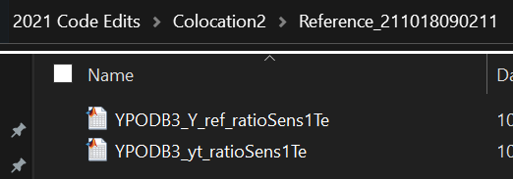
Outputs > Reference
If using one-hop, a “Reference” folder will appear in the “Calibration2” folder
A new one is generated on each run with the datetime string it was created
Y_ref: “reference” estimates for the universal pod during the secondary colocation
yt: matching timestamps for the secondary colocation

Slide 55
Outputs > Database
If settingsSet.database is true, generates .txt files to be saved to database
One of each for each pod
Colocation: pod data, estimate, timestamps, and reference data
Colocation2: same info but for one-hop & calibrating pod only
Field: pod data, estimate, and timestamps for field data
settingsSet: all run settings as a text file
deployLog: entire deployment log in text file format

Slide 56
Key Changes from Previous Versions

Slide 57
Key Changes from Version 3.3
“regtype” no longer included in settingsSet
Previously, used had to note the type of regression used in code – either linear regression, ANN, RF, etc.
New handling relies on calibration model naming convention being followed
If calibration model name includes ‘NN’ or ‘RF’, will handle as appropriate

Slide 58
Key Changes from (older) Previous Versions
Calibration & field all in one code!
Compatible with different types of machine learning (linreg, ann, universal)
One version of plotting functions, stat functions, etc. used
Names & structures have been edited
Update Addtl. Matlab Functions to have the correct version
Structure of calibration models has changed
Older file versions of anything in Addtl. Matlab Functions > Calibration Models will be incompatible
See next slide for more info

Slide 59
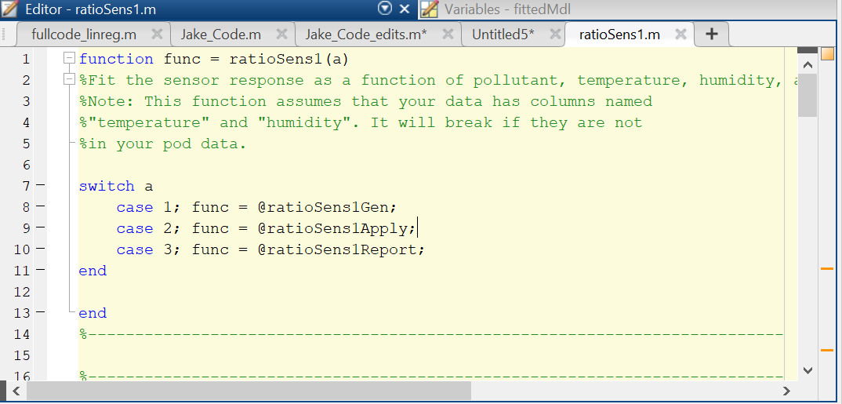
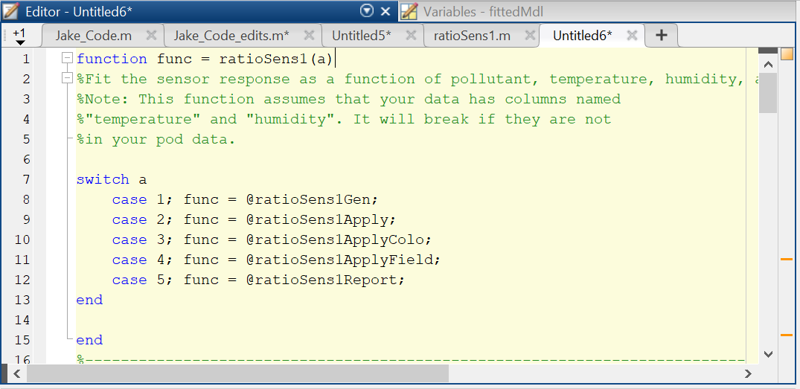
Added functionality by adding additional cases to EACH calibration model
Originally 3 cases:
Generate calibration
Apply calibration to cal/val folds
Report out on calibration
Now requires 5 cases:
Generate calibration
Apply calibration to cal/val folds
Apply calibration to ALL colocation data
Apply calibration to field data
Report out on calibration
Make sure you’ve updated “Addtl Matlab Functions” folder to have the correct versions of the cal models!!

Slide 60
Note on Calibration Models
Only regression models have been updated for this version
We only use regression for determining concentration estimates
Regression has a continuous output
E.g. estimate methane concentration, which can be any number (infinite possible outcomes)
Classification models still available in archive
Would need the format updated as shown on previous slide in order to use
Classification has a discrete output
E.g determine whether a measurement represents oil & gas activity or not (2 possible outcomes)

